Slide 1
Nominee Company Name
Company Address

Slide 2
[Must be between Oct 1, 2021 – December 31, 2022]
[Insert Title of Campaign]
[Insert Industry, i.e., Behavioral Health, Home Health Care, Skilled Nursing, etc.]
[Insert Campaign Category, i.e., New Brand Launch, Social Media Campaign, Rebranding, etc.]
[Insert Provider / Operator / Company]
[Name], [Title], [Number], [email]
[Insert Agency or Firm]
[Insert Agency Contact Info]
[Insert Credits]

Slide 3
(500 words max)
Visit our website for more information on the judging process.
Company and project story. Description of the company and design. Description of design inspiration. What makes this project stand out in this category. This should fill approximately 500 words. This should fill approximately 500 words. This should fill approximately 500 words. This should fill approximately 500 words. This should fill approximately 500 words. This should fill approximately 500 words. This should fill approximately 500 words. This should fill approximately 500 words. This should fill approximately 500 words. This should fill approximately 500 words. This should fill approximately 500 words. This should fill approximately 500 words. This should fill approximately 500 words. This should fill approximately 500 words. This should fill approximately 500 words. This should fill approximately 500 words. This should fill approximately 500 words. This should fill approximately 500 words. This should fill approximately 500 words. This should fill approximately 500 words. This should fill approximately 500 words. This should fill approximately 500 words. This should fill approximately 500 words. This should fill approximately 500 words. This should fill approximately 500 words. This should fill approximately 500 words. This should fill approximately 500 words. This should fill approximately 500 words. This should fill approximately 500 words. This should fill approximately 500 words. This should fill approximately 500 words. This should fill approximately 500 words. This should fill approximately 500 words. This should fill approximately 500 words. This should fill approximately 500 words. This should fill approximately 500 words. This should fill approximately 500 words. This should fill approximately 500 words. This should fill approximately 500 words. This should fill approximately 500 words. This should fill approximately 500 words. This should fill approximately 500 words. This should fill approximately 500 words. This should fill approximately 500 words. This should fill approximately 500 words. This should fill approximately 500 words. This should fill approximately 500 words. This should fill approximately 500 words. This should fill approximately 500 words. This should fill approximately 500 words. This should fill approximately 500 words. This should fill approximately 500 words. This should fill approximately 500 words. This should fill approximately 500 words. This should fill approximately 500 words. This should fill approximately 500 words. This should fill approximately 500 words. This should fill approximately 500 words. This should fill approximately 500 words. This should fill approximately 500 words. This should fill approximately 500 words. This should fill approximately 500 words. This should fill approximately 500 words. This should fill approximately 500 words. This should fill approximately 500 words. This should fill approximately 500 words. This should fill approximately 500 words. This should fill approximately 500 words. This should fill approximately 500 words. This should fill approximately 500 words. This should fill approximately 500 words. This should fill approximately 500 words. This should fill approximately 500 words. This should fill approximately 500 words. This should fill approximately 500 words. This should fill approximately 500 words. This should fill approximately 500 words. This should fill approximately 500 words. This should fill approximately 500 words. This should fill approximately 500 words.

Slide 5
Campaign Title | Campaign Category/Description
Our design team reworked out layouts and templates to showcase each presenter for optimized views on both desktop/tablet and mobile experiences.

Slide 6
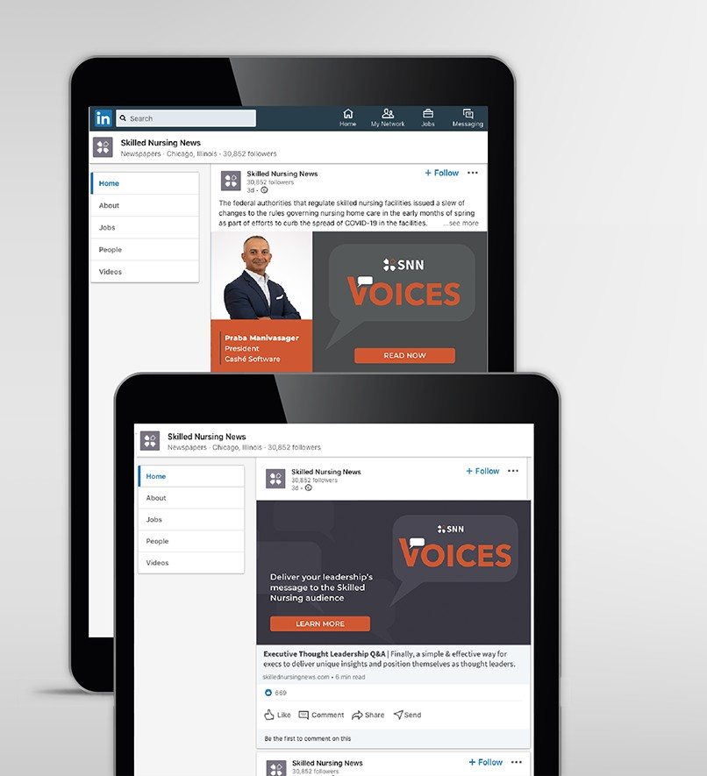
Campaign Title | Campaign Category/Description
Key items addressed in launch:
Focus on high quality imagery of Voices Speaker
High visibility and testing focused on professional
Strong engagement on LinkedIn and Facebook
Concentrated advertising to drive new inquiries for program
Results:
Paired with our marketing plan, we saw an xx% increase in traffic to this site

Slide 7
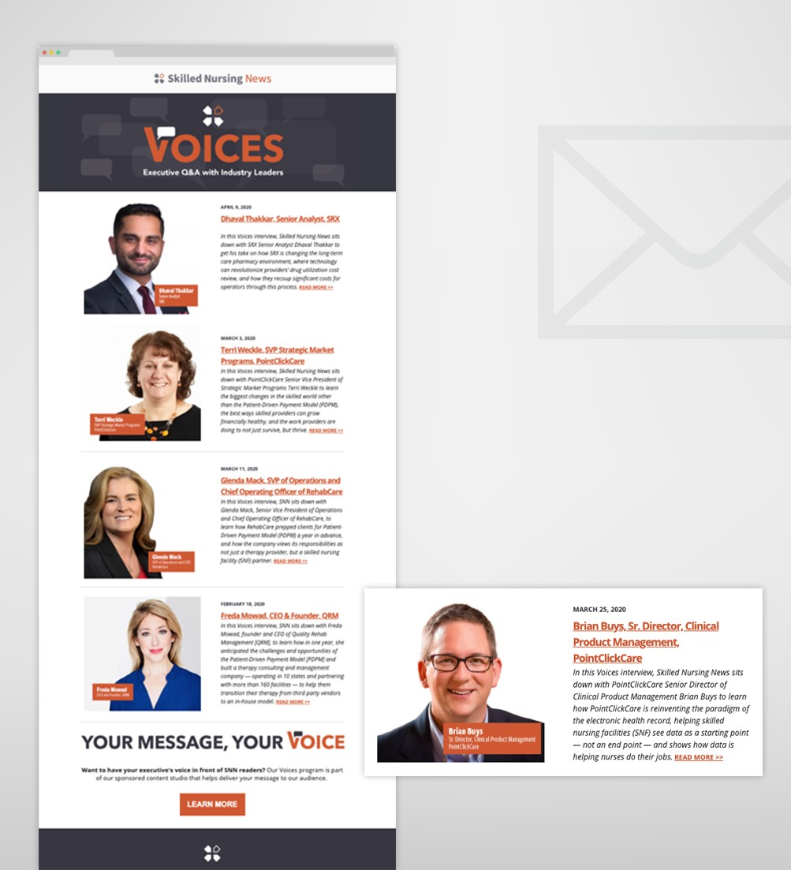
Campaign Title | Campaign Category/Description
Key items addressed in campaign:
Focus on high quality imagery of Voices Speaker
High visibility and testing focused on professional
Showcasing broad range of executives in various areas of program highlighting their expertise and varied backgrounds.
Results:
Paired with our marketing plan, we saw an xx% increase in traffic to this site

